Slide 1
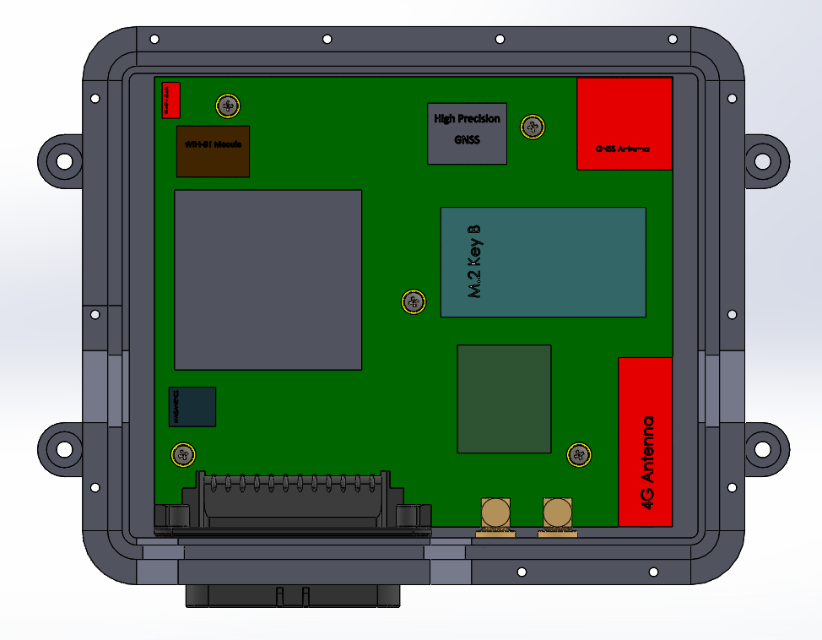
WIFI BT Antenna
GNSS Antenna
4G Antenna

Slide 2
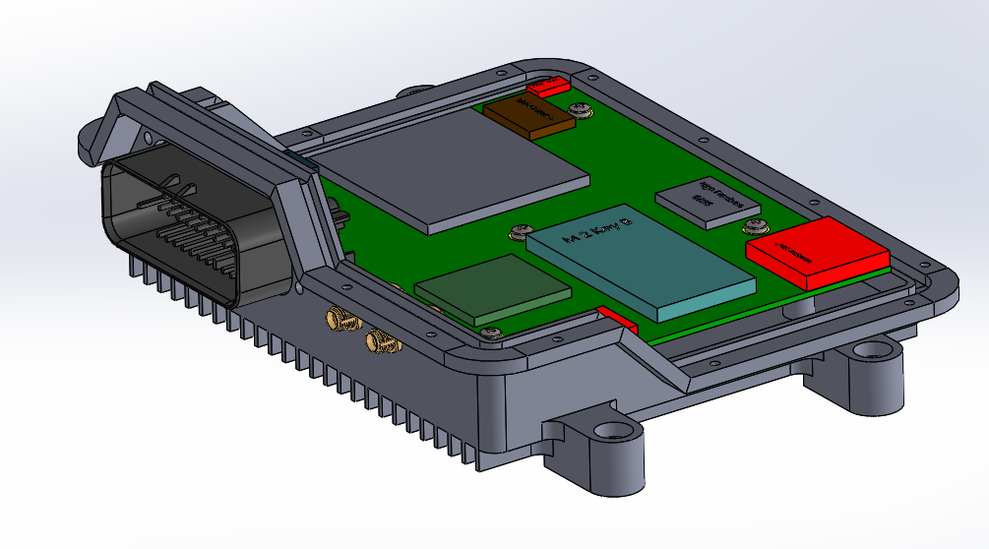

Slide 3
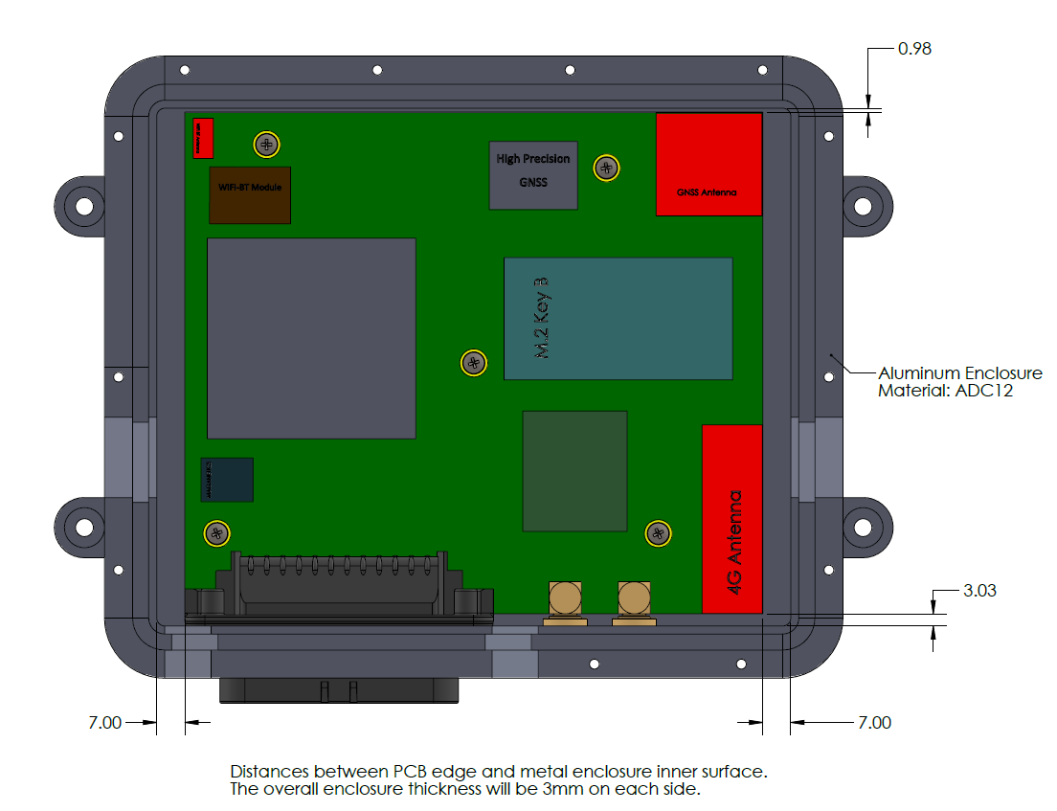

Slide 4
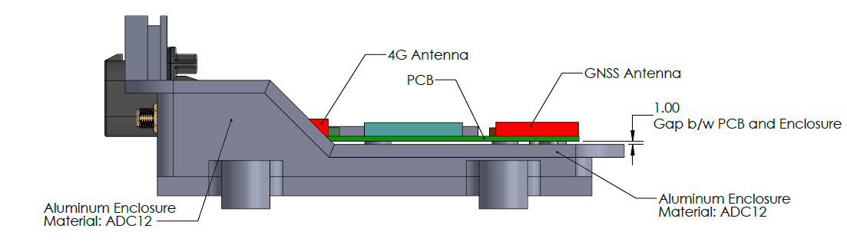

Slide 5
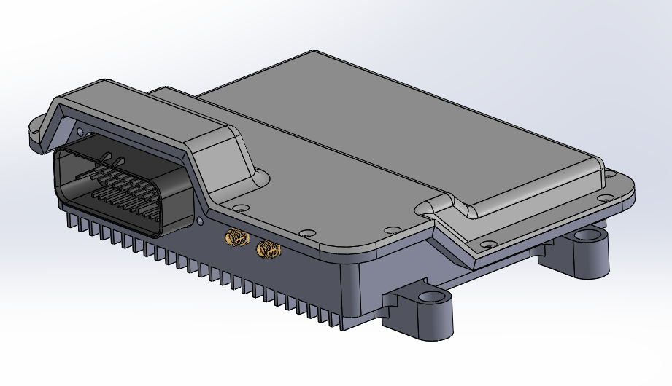
Plastic Top
Material: PC or PC-ABS Blend
Metal Bottom
Material: Aluminium or ADC12

